Slide 1
Artificial Neural Networks
D.A. Tamburri

Slide 2
What will you learn today?
What t.h. are ANNs?
What are their functioning principles?
When do I use them?

Slide 3
Machine-Learning Callback
Machine-Learning includes several techniques, not a single one;
Combination of multiple approaches and angles are also possible (known as “ensemble” techniques);

Slide 4
So, On our way to machine-learning...
Artificial Neural Networks!

Slide 5
Artificial Neural Networks
A Bit of History
Biological Inspiration
Artificial Neurons (AN)
Artificial Neural Networks (ANN)
Training an ANN -- Learning

Slide 6
Brief History of Neural Networks
1943: McCulloch & Pitts show that neurons can be combined to construct a Turing machine (using ANDs, ORs, & NOTs)
1958: Rosenblatt shows that perceptrons will converge if what they are trying to learn can be represented
1969: Minsky & Papert showed the limitations of perceptrons, killing research for a decade
1985: The backpropagation algorithm revitalizes the field
Geoff Hinton et al
2006: The Hinton lab solves the training problem for DNNs

Slide 7
Biological Inspiration: Neurons
A neuron has
Branching input (dendrites)
Branching output (the axon)
Information moves from the dendrites to the axon via the cell body
Axon connects to dendrites via synapses
Synapses vary in strength
Synapses may be excitatory or inhibitory

Slide 8
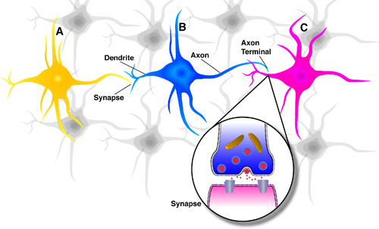
What is an Artificial Neuron?
An Artificial Neuron (AN) is a non-linear parameterized function with restricted output range
y
b
w₁
w₂
w₃
x1
x2
x3
Lets blow this up a bit
Spike-Timing Dependent Plasticity (STDP)
Notes:
http://en.wikipedia.org/wiki/Hebbian_theory

Slide 9
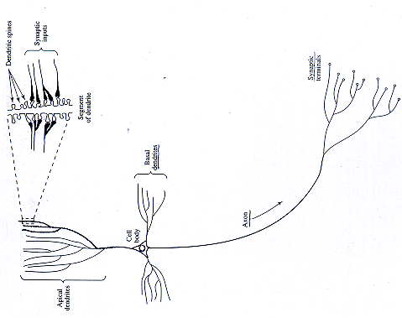
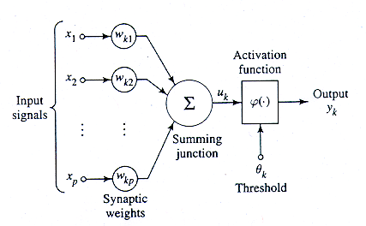
Mapping to Biological Neurons
Dendrite
Cell Body
Axon

Slide 10
So, ANN basics assumption is...
Let’s imitate the uses and functioning of the basic compute unit in the human brain, i.e., neuron!
Basic compute unit for ANNs, i.e., Perceptron!

Slide 11
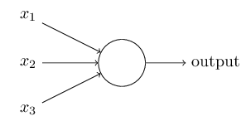
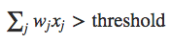
How do Perceptron ANNs work...
1. weights, w1,w2,…, real numbers expressing the importance of the respective inputs to the output.
w1
w2
T
w3
2. The neuron's output, 0 or 1, is determined by whether the weighted sum ∑_{j}w_{j}x_{j} is less than or greater than some threshold value T:
Notes:
http://neuralnetworksanddeeplearning.com/chap1.html

Slide 12
How do Perceptron ANNs work...
1. weights, w1,w2,…, real numbers expressing the importance of the respective inputs to the output.
w1
w2
T
w3
2. The neuron's output, 0 or 1, is determined by whether the weighted sum ∑_{j}w_{j}x_{j} is less than or greater than some threshold value T:
Notes:
http://neuralnetworksanddeeplearning.com/chap1.html

Slide 13
How do Perceptron ANNs work...
1. weights, w1,w2,…, real numbers expressing the importance of the respective inputs to the output.
w1
w2
T
w3
2. The neuron's output, 0 or 1, is determined by whether the weighted sum ∑_{j}w_{j}x_{j} is less than or greater than some threshold value T:
- Bias!
3. Bias -> a measure of how easy it is to get the perceptron to output a 1 (i.e., the threshold but negated)
Notes:
http://neuralnetworksanddeeplearning.com/chap1.html

Slide 14
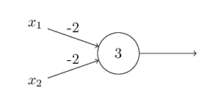
for Example...
A single perceptron to calculate the !AND (NAND) expression between 2 nums…
Bias == - threshold

Slide 15

An Example
A single perceptron to calculate the !AND (NAND) expression between 2 nums…
For the sake of argument
Let’s assume -2,-2 and 3
were picked at random
Bias == - threshold

Slide 16
An Example
A single perceptron to calculate the !AND (NAND) expression between 2 nums…
Bias == - threshold... Lets bring the threshold on the other side of the equation...

Slide 17
An Example
A single perceptron to calculate the !AND (NAND) expression between 2 nums…
Bias == - threshold... Lets bring the threshold on the other side of the equation...
- threshold > 0

Slide 18
An Example
A single perceptron to calculate the !AND (NAND) expression between 2 nums…
Bias == - threshold... Lets bring the threshold on the other side of the equation...
3. Bias -> a measure of how easy it is to get the perceptron to output a 1 (i.e., the threshold but negated)
Bias! ➔ - threshold
Why?

Slide 19
An Example
A single perceptron to calculate the !AND (NAND) expression between 2 nums…
Bias == - threshold... Lets bring the threshold on the other side of the equation...
3. Bias -> a measure of how easy it is to get the perceptron to output a 1 (i.e., the threshold but negated)
Bias! ➔ - threshold
Because...

Slide 20
Now... Let’s look for a baseline for our NAND function
A single perceptron to calculate the !AND (NAND) expression between 2 nums…
Bias == - threshold... Lets bring the threshold on the other side of the equation...
3. Bias -> a measure of how easy it is to get the perceptron to output a 1 (i.e., the threshold but negated)
Bias! ➔ - threshold
Because...

Slide 21
Now... Let’s look for a baseline for our NAND function
A single perceptron to calculate the !AND (NAND) expression between 2 nums…
NAND ➔ !AND operator ➔ Boolean Logic, negation of the conjunction of two formulae

Slide 22
Now... Let’s look for a baseline for our NAND function
A single perceptron to calculate the !AND (NAND) expression between 2 nums…
NAND ➔ !AND operator ➔ Boolean Logic, negation of the conjunction of two formulae

Slide 23
Now... Let’s look for a baseline for our NAND function
A single perceptron to calculate the !AND (NAND) expression between 2 nums…
NAND ➔ !AND operator ➔ Boolean Logic, negation of the conjunction of two formulae
Truth Tables!

Slide 24
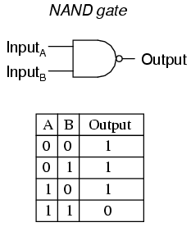
Now... Let’s look for a baseline for our NAND function
NAND Truth Table
- These are the rules of the game...

Slide 25
Now... Let’s look for a baseline for our NAND function
NAND Truth Table
- These are the rules of the game...
- This is the function to approximate!

Slide 26
Back to our Example
A single perceptron to calculate the !AND (NAND) expression between 2 nums…
- threshold > 0
This is my computational model
Notes:
correct thresholds with bias

Slide 27
Back to our Example
A single perceptron to calculate the !AND (NAND) expression between 2 nums…
- threshold > 0
These are the rules that the
Model should be trained to
Match...

Slide 28
What’s my ML Goal?
A single perceptron to calculate the !AND (NAND) expression between 2 nums…
- threshold > 0
How do I formulate my ML training campaign?

Slide 29
Here’s what should happen...
A single perceptron to calculate the !AND (NAND) expression between 2 nums…
00 ➔(−2)∗0+(−2)∗0+3=3 > 0 ➔ perceptron “fires” 1

Slide 30
Here’s what should happen...
A single perceptron to calculate the !AND (NAND) expression between 2 nums…
00 ➔(−2)∗0+(−2)∗0+3=3 > 0 ➔ perceptron “fires” 1
01 ➔(−2)∗0+(−2)∗1+3=1 > 0 ➔ perceptron “fires” 1

Slide 31
Here’s what should happen...
A single perceptron to calculate the !AND (NAND) expression between 2 nums…
00 ➔(−2)∗0+(−2)∗0+3=3 > 0 ➔ perceptron “fires” 1
01 ➔(−2)∗0+(−2)∗1+3=1 > 0 ➔ perceptron “fires” 1
10 ➔ <same as above only inverted values of X₁ and X₂>

Slide 32
Here’s what should happen...
A single perceptron to calculate the !AND (NAND) expression between 2 nums…
00 ➔(−2)∗0+(−2)∗0+3=3 > 0 ➔ perceptron “fires” 1
01 ➔(−2)∗0+(−2)∗1+3=1 > 0 ➔ perceptron “fires” 1
10 ➔ <same as above only inverted values of X₁ and X₂>
11 ➔ (−2)∗1+(−2)∗1+3=−1< 0 ➔ perceptron “fires” 0

Slide 33
Hold on a sec...
A single perceptron to calculate the !AND (NAND) expression between 2 nums…
The perceptron already does what
It’s supposed to do!!!
Why?
00 ➔(−2)∗0+(−2)∗0+3=3 > 0 ➔ perceptron “fires” 1
01 ➔(−2)∗0+(−2)∗1+3=1 > 0 ➔ perceptron “fires” 1
10 ➔ <same as above only inverted values of X₁ and X₂>
11 ➔ (−2)∗1+(−2)∗1+3=−1< 0 ➔ perceptron “fires” 0

Slide 34
Hold on a sec...
A single perceptron to calculate the !AND (NAND) expression between 2 nums…
Remember when I told you that -2, -2 and 3...Were RANDOM?

Slide 35
Hold on a sec...
A single perceptron to calculate the !AND (NAND) expression between 2 nums…
I lied ☺

Slide 36

Hold on a sec...
A single perceptron to calculate the !AND (NAND) expression between 2 nums…
Everybody lies, including ML models.

Slide 37
Hold on a sec...
A single perceptron to calculate the !AND (NAND) expression between 2 nums…
These numbers were learned...

Slide 38
An Example
This perceptron successfully approximates
The NAND logical function!
f(x₁,x₂)= !∧(x₁,x₂);

Slide 39
How did we get there in the first place?
How were the values (-2,-2) and 3 set for the perceptron?

Slide 40
How did we get there in the first place?
How were the values (-2,-2) and 3 set for the perceptron?
Start from randomized nums and “experiment” with them, until desired result shows up!

Slide 41
How did we get there in the first place?
How were the values (-2,-2) and 3 set for the perceptron?
Start from randomized numbers and “experiment” with them, until desired result shows up!
Ok, but... NAND needs only 1 perceptron and is a “simple” yet powerful problem, what of complex ones?

Slide 42
How did we get there in the first place?
How were the values (-2,-2) and 3 set for the perceptron?
Start from randomized numbers and “experiment” with them, until desired result shows up!
Ok, but... NAND needs only 1 perceptron and is a “simple” yet powerful problem, what of complex ones?

Slide 43
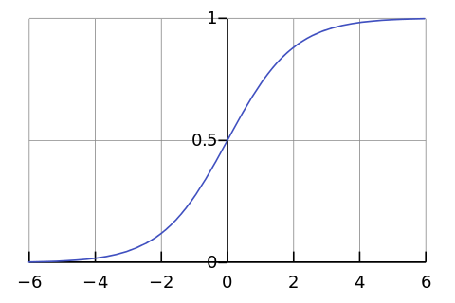
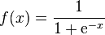
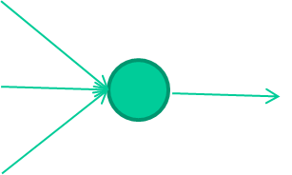
Rather than no function, we use an approx. function, e.g., sigmoid...
-0.06
W1
W2
f(x)
-2.5
W3
The sigmoid modifies the entity of the result of one perceptron so that the output is adjusted *gradually* (in ®), rather than categorically, 0 or 1
1.4

Slide 44
-0.06
2.7
-8.6
f(x)
-2.5
0.002
x = -0.06×2.7 + 2.5×8.6 + 1.4×0.002 = 21.34
1.4

Slide 45
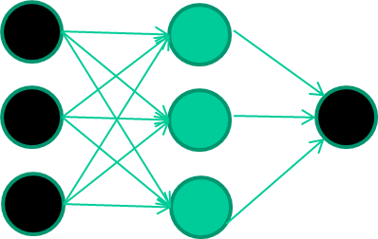
A dataset
Fields class
1.4 2.7 1.9 0
3.8 3.4 3.2 0
6.4 2.8 1.7 1
4.1 0.1 0.2 0
etc …

Slide 46
Training the neural network
Fields class
1.4 2.7 1.9 0
3.8 3.4 3.2 0
6.4 2.8 1.7 1
4.1 0.1 0.2 0
etc …

Slide 47
Training data
Fields class
1.4 2.7 1.9 0
3.8 3.4 3.2 0
6.4 2.8 1.7 1
4.1 0.1 0.2 0
etc …
Initialise with random weights

Slide 48
Training data
Fields class
1.4 2.7 1.9 0
3.8 3.4 3.2 0
6.4 2.8 1.7 1
4.1 0.1 0.2 0
etc …
Present a training pattern
1.4
2.7
1.9

Slide 49
Training data
Fields class
1.4 2.7 1.9 0
3.8 3.4 3.2 0
6.4 2.8 1.7 1
4.1 0.1 0.2 0
etc …
Feed it through to get output
1.4
2.7 0.8
1.9

Slide 50
Training data
Fields class
1.4 2.7 1.9 0
3.8 3.4 3.2 0
6.4 2.8 1.7 1
4.1 0.1 0.2 0
etc …
Compare with target output
1.4
2.7 0.8
0
1.9 error 0.8

Slide 51


Training data
Fields class
1.4 2.7 1.9 0
3.8 3.4 3.2 0
6.4 2.8 1.7 1
4.1 0.1 0.2 0
etc …
Adjust weights based on error
1.4
2.7 0.8
0
1.9 error 0.8

Slide 52
Training data
Fields class
1.4 2.7 1.9 0
3.8 3.4 3.2 0
6.4 2.8 1.7 1
4.1 0.1 0.2 0
etc …
Present a training pattern
6.4
2.8
1.7

Slide 53
Training data
Fields class
1.4 2.7 1.9 0
3.8 3.4 3.2 0
6.4 2.8 1.7 1
4.1 0.1 0.2 0
etc …
Feed it through to get output
6.4
2.8 0.9
1.7

Slide 54
Training data
Fields class
1.4 2.7 1.9 0
3.8 3.4 3.2 0
6.4 2.8 1.7 1
4.1 0.1 0.2 0
etc …
Compare with target output
6.4
2.8 0.9
1
1.7 error -0.1

Slide 55
Training data
Fields class
1.4 2.7 1.9 0
3.8 3.4 3.2 0
6.4 2.8 1.7 1
4.1 0.1 0.2 0
etc …
Adjust weights based on error
6.4
2.8 0.9
1
1.7 error -0.1

Slide 56
Training data
Fields class
1.4 2.7 1.9 0
3.8 3.4 3.2 0
6.4 2.8 1.7 1
4.1 0.1 0.2 0
etc …
And so on ….
6.4
2.8 0.9
1
1.7 error -0.1
Repeat this thousands, maybe millions of times – each time
taking a random training instance, and making slight
weight adjustments
Algorithms for weight adjustment are designed to make
changes that will reduce the error

Slide 57
Training data
Fields class
1.4 2.7 1.9 0
3.8 3.4 3.2 0
6.4 2.8 1.7 1
4.1 0.1 0.2 0
etc …
And so on ….
6.4
2.8 0.9
1
1.7 error -0.1
I call the stepping
Down (or up) of the
Fixes, as learning rate

Slide 58
Summary: Artificial neurons
An Artificial Neuron is a non-linear parameterized function with restricted output range
y
w0
w₀ also called a bias term (b_{i})
x1
x2
x3

Slide 59
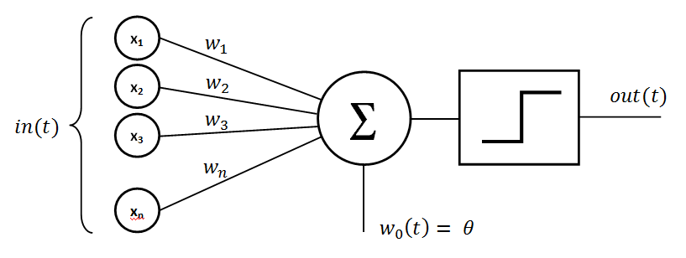
Basic Perceptron*
What is the problem
here?
(Rosenblatt, 1950s and early 60s)

Slide 60

Basic Perceptron*
Trust me… there is something missing here…
Lollipop time!
(Rosenblatt, 1950s and early 60s)

Slide 61
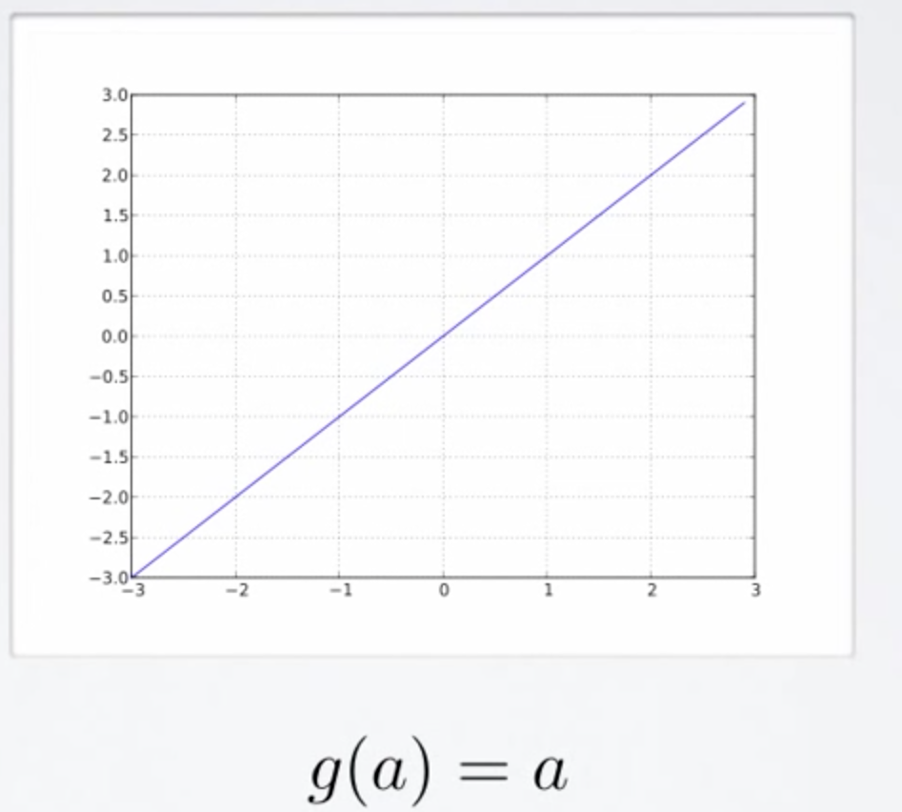
Activation Functions – Linear Function
Performs no input squashing of any kind;
Actually not very interesting…

Slide 62
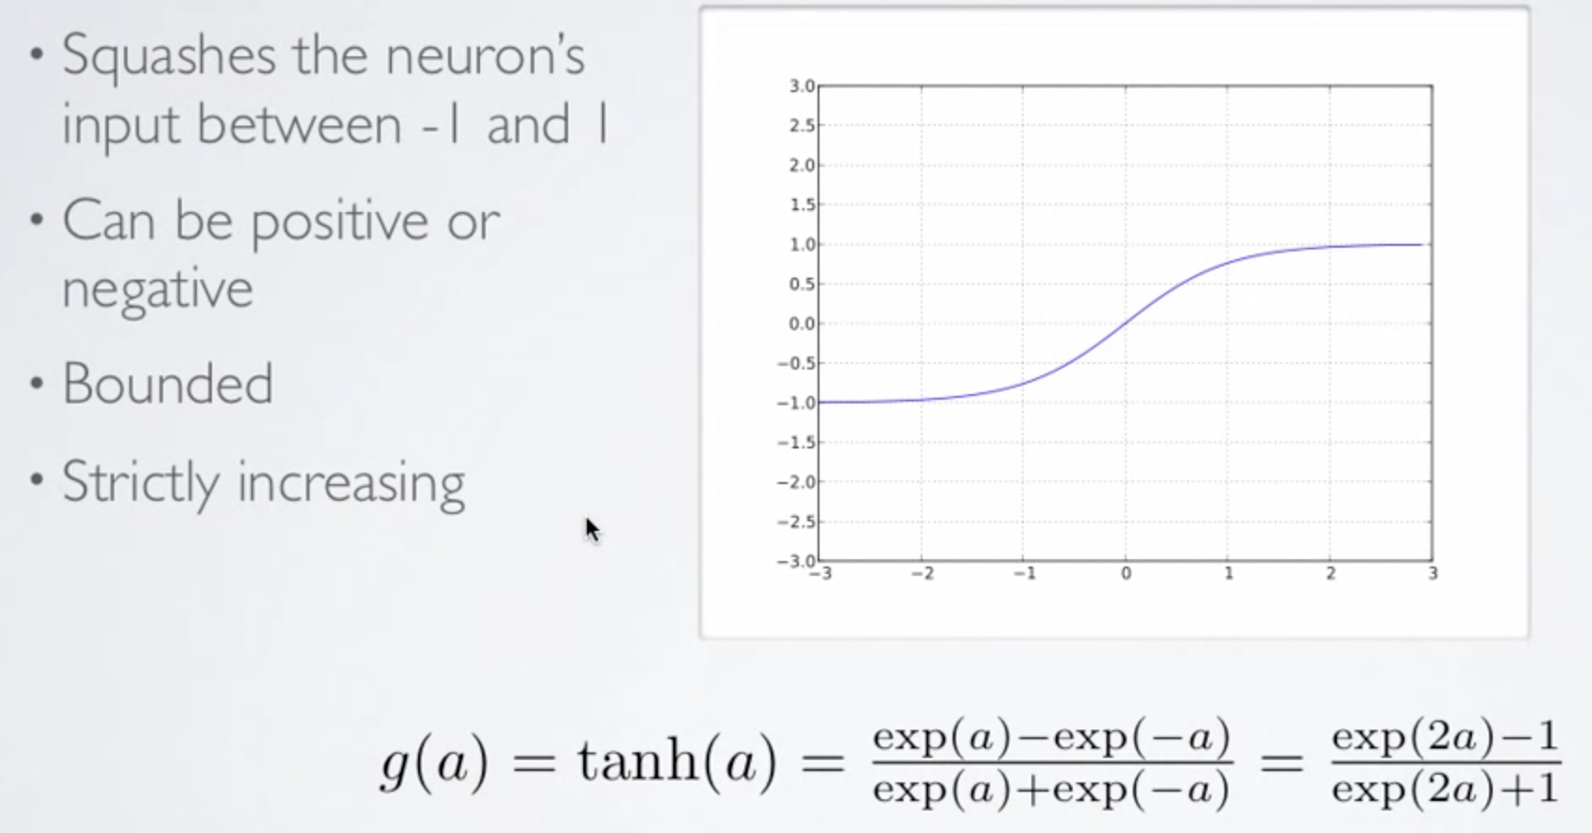
Activation Functions – Hyperbolic Tangent
Squashes perceptron input between -1 and 1;
Can be positive or negative;
Is bounded by definition;
Strictly increasing;

Slide 63
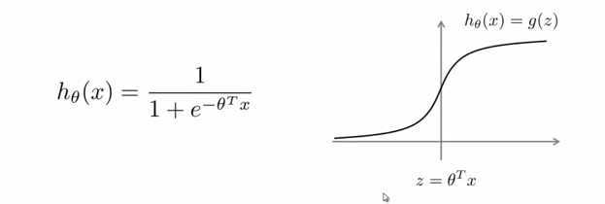
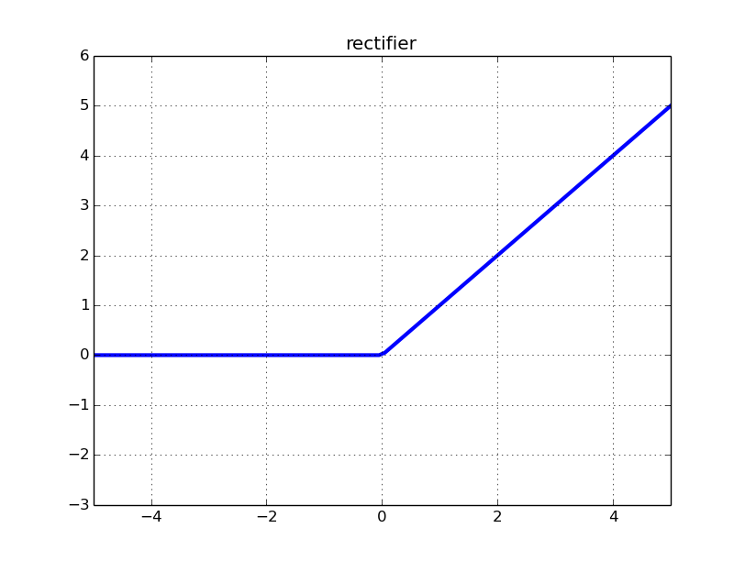
Activation Functions: More Recently...
Recent successes (e.g., Baidu Deep Speech) use
(clipped) Rectifier Linear Units:
f(x) = max(0,x) -- rectifier
f(x) = min(max(0,x), clip)
Smooth approximation (softplus):
Squashes the input (x) onto the open interval [0,1]

Slide 64
But...
How do we choose among multiple options?

Slide 65

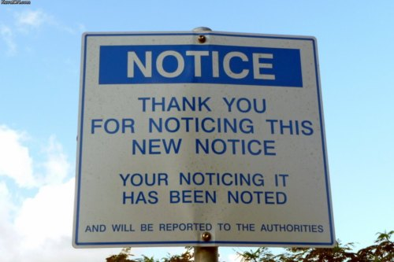
Short Break?
15 min Break?
Coming up next... Decision Surfaces!

Slide 66
Choosing an Activation Function
Choosing an activation function rather than another one changes the result of the ANN (obvious);
Problem: how do I choose?

Slide 67
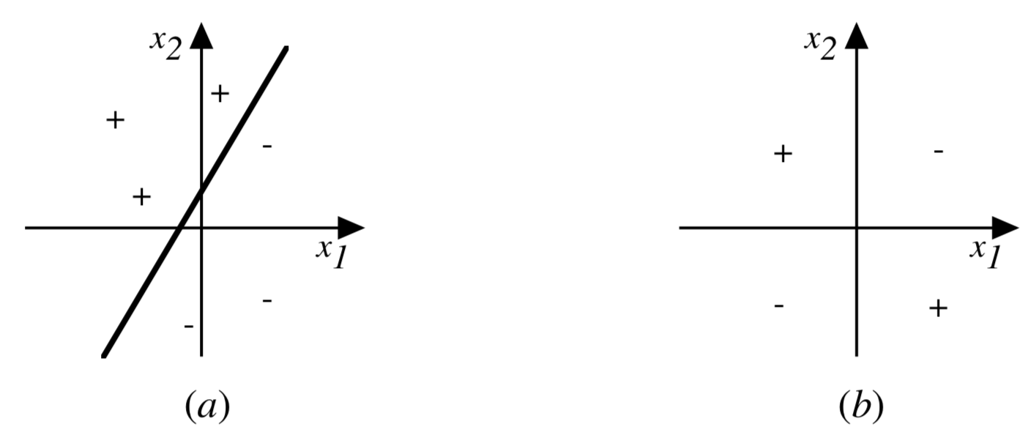
Choosing an Activation Function
Choosing an activation function rather than another one changes the result of the ANN (obvious);
Problem: how do I choose?
Decision
Surface!

Slide 68
Decision Surfaces
Def: “is a hypersurface that partitions the underlying vector space into two sets, one for each class.”
Notes:
In a statistical-classification problem with two classes, a decision boundary or decision surface is a hypersurface that partitions the underlying vector space into two sets, one for each class. ... A decision boundary is the region of a problem space in which the output label of a classifier is ambiguous.

Slide 69

Decision Surfaces
Def: “is a hypersurface that partitions the underlying vector space into two sets, one for each class.”
Quoth’ the raven... “Say what?!”

Slide 70
Decision Surfaces
Def: “is a hypersurface that partitions the underlying vector space into n sets, one for each class.”
A hypersurface is a manifold, i.e., a topological space that locally resembles an Euclidian space

Slide 71
Decision Surfaces
Def: “is a hypersurface that partitions the underlying vector space into n sets, one for each class.”
A Hypersurface is a manifold, i.e., a topological space that locally resembles an Euclidian space…
Quoth’ the raven... “Say what?!”

Slide 72
Decision Surfaces
Def: “is a hypersurface that partitions the underlying vector space into n sets, one for each class.”
A Hypersurface is a manifold, i.e., a topological space that locally resembles an Euclidian space…
Just a complex mathematical jargon to say that a hypersurface reflects a polyhedron (e.g., a sphere, a plane, the torus, …);

Slide 73
Decision Surfaces
Def: “is a hypersurface that partitions the underlying vector space into n sets, one for each class.”
A Hypersurface is a manifold, i.e., a topological space that locally resembles an Euclidian space…
Just a complex mathematical jargon to say that a hypersurface reflects a polyhedron (e.g., a sphere, a plane, the torus, …);

Slide 74

Decision Surfaces
Not this torus...

Slide 75

Decision Surfaces
Or this torus
But, getting warmer…

Slide 76
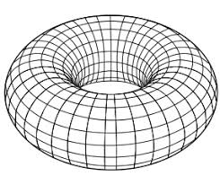
Decision Surfaces
This torus

Slide 77
Decision Surfaces
This torus
Locally...
It can be made to represent a Euclidean space!

Slide 78
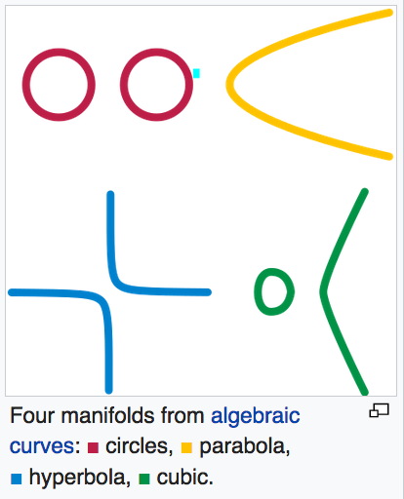
More from wikipedia...
Manifolds (and hypersurfaces) exist also for standard algebraic curves!

Slide 79
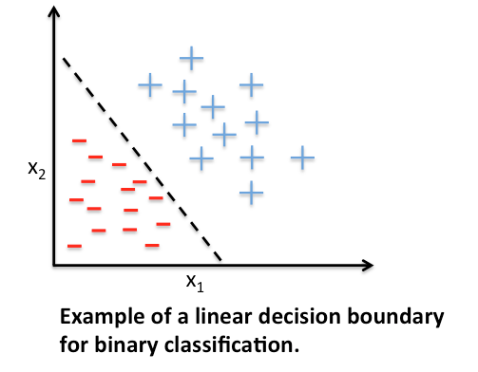
Decision Surfaces

Slide 80
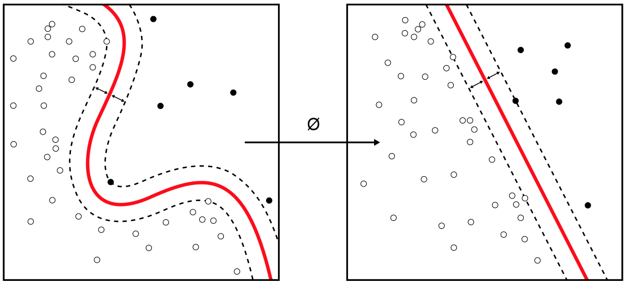
Decision Surfaces

Slide 81
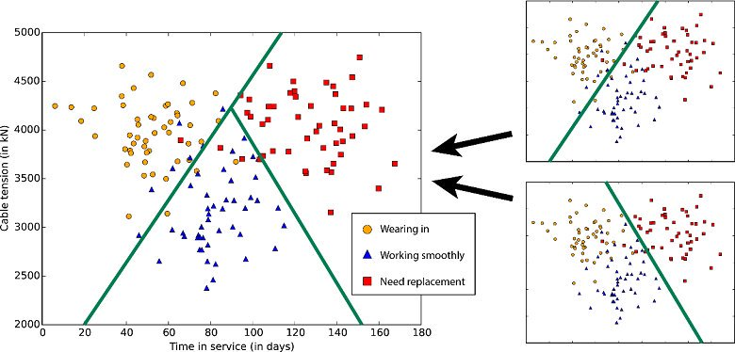
Decision Surfaces

Slide 82
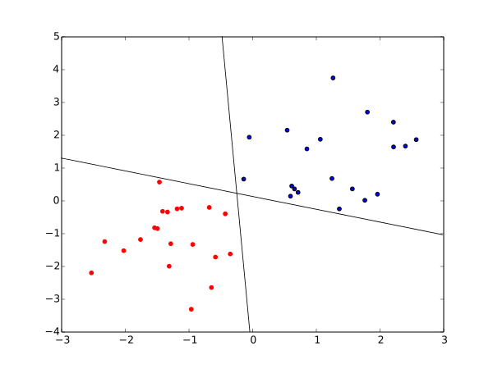
Decision Surfaces

Slide 83
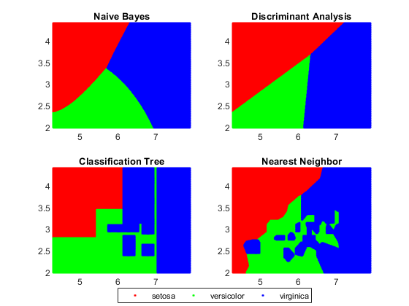
Decision Surfaces

Slide 84
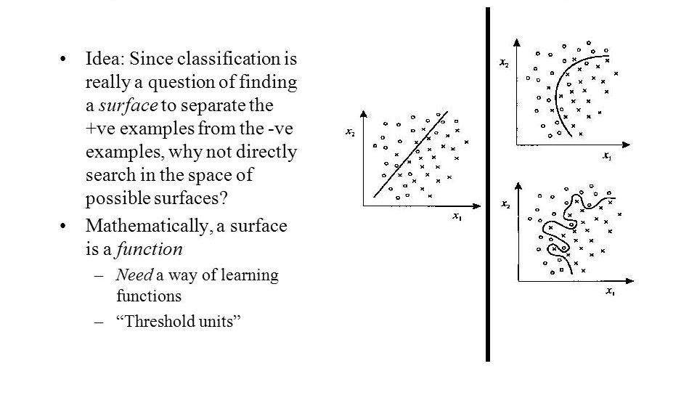
Decision Surfaces

Slide 85
Back to us: Decision Surfaces
Def: “is a hypersurface that partitions the underlying vector space into n sets, one for each class.”

Slide 86
Decision Surfaces: another example
Def: “is a hypersurface that partitions the underlying vector space into n sets, one for each class.”
A Hypersurface is a manifold, i.e., a topological space that locally resembles an Euclidian space…
What is the Decision Surface of a geo-localization ML algorithm?

Slide 87

Decision Surfaces: another example
Def: “is a hypersurface that partitions the underlying vector space into n sets, one for each class.”
A Hypersurface is a manifold, i.e., a topological space that locally resembles an Euclidian space…
What is the Decision Surface of a geo-localization ML algorithm?

Slide 88
The Geolocalization ML decision surface
Def: “is a hypersurface that partitions the underlying vector space into n sets, one for each class.”
What is the Decision Surface of a geo-localization ML algorithm?

Slide 89
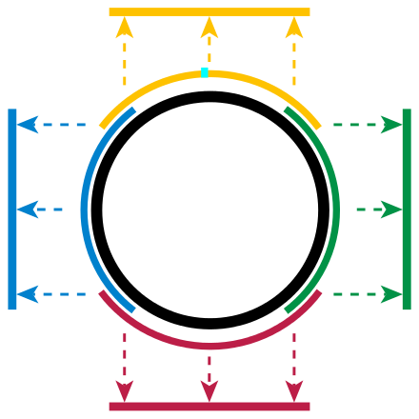
The Geolocalization ML decision surface
Def: “is a hypersurface that partitions the underlying vector space into n sets, one for each class.”
What is the Decision Surface of a geo-localization ML algorithm?
I would say, something like this...

Slide 90
The Geolocalization ML decision surface
Def: “is a hypersurface that partitions the underlying vector space into n sets, one for each class.”
What is the Decision Surface of a geo-localization ML algorithm?
Why?
<moment of suspense…>

Slide 91
The Geolocalization ML decision surface
Def: “is a hypersurface that partitions the underlying vector space into n sets, one for each class.”
What is the Decision Surface of a geo-localization ML algorithm?
→ Geo-localization algo. Can classify location based on hemisphere!
→ But this is not the only possible option!

Slide 92
So... Choosing an Activation Function
Choosing an activation function is non-trivial, depends on ML problem and the space of data & solution heavily affects the choice
Problem: how do I choose?
Decision
Surface!

Slide 93
So... Choosing an Activation Function
Choosing an activation function is non-trivial, depends on ML problem and the space of data & solution heavily affects the choice
Problem: how do I choose?
The Decision Surface
Can help me understand
Whether the problem is
Linearly separable!

Slide 94
So... Choosing an Activation Function
Choosing an activation function is non-trivial, depends on ML problem and the space of data & solution heavily affects the choice
Problem: how do I choose?
The Decision Surface
Can help me understand
Whether the problem is
Linearly separable!

Slide 95
So... Choosing an Activation Function
Choosing an activation function is non-trivial, depends on ML problem and the space of data & solution heavily affects the choice
Problem: how do I choose?
The Decision Surface
Can help me understand
Whether the problem is
Linearly separable!

Slide 96
Perceptron Training Rule
If training data is linearly separable
AND
Learning rate is sufficiently small
THEN
Perceptron training will converge towards solution!*
*Perceptron Convergence Theorem ⬅ Need-To-Know.
Notes:
http://euclid.nmu.edu/~mkowalcz/cs495f09/slides/lesson014.pdf
http://aass.oru.se/~lilien/ml/seminars/2007_02_01b-Janecek-Perceptron.pdf
http://hagan.okstate.edu/4_Perceptron.pdf

Slide 97
Perceptron Training Rule
If training data is linearly separable
AND
Learning rate is sufficiently small
THEN
Perceptron training will converge towards solution!
As part of your experimentation:
(a) find a learning rate that is low enough that the network converges to something useful…
*AND*
(b) high enough that you don't have to spend years training it!
Notes:
http://euclid.nmu.edu/~mkowalcz/cs495f09/slides/lesson014.pdf
http://aass.oru.se/~lilien/ml/seminars/2007_02_01b-Janecek-Perceptron.pdf
http://hagan.okstate.edu/4_Perceptron.pdf

Slide 98
Perceptron Training Rule
If training data is linearly separable
AND
Learning rate is sufficiently small
THEN
Perceptron training will converge towards solution!
As part of your experimentation:
(a) find a learning rate that is low enough that the network converges to something useful…
*AND*
(b) high enough that you don't have to spend years training it!
Notes:
http://euclid.nmu.edu/~mkowalcz/cs495f09/slides/lesson014.pdf
http://aass.oru.se/~lilien/ml/seminars/2007_02_01b-Janecek-Perceptron.pdf
http://hagan.okstate.edu/4_Perceptron.pdf

Slide 99
Perceptron Training Rule
If training data is linearly separable
AND
Learning rate is sufficiently small
THEN
Perceptron training will converge towards solution!
As part of your experimentation:
(a) find a learning rate that is low enough that the network converges to something useful…
*AND*
(b) high enough that you don't have to spend years training it!
Notes:
http://euclid.nmu.edu/~mkowalcz/cs495f09/slides/lesson014.pdf
http://aass.oru.se/~lilien/ml/seminars/2007_02_01b-Janecek-Perceptron.pdf
http://hagan.okstate.edu/4_Perceptron.pdf

Slide 100
Perceptron Training Rule
If training data is linearly separable
AND
Learning rate is sufficiently small
THEN
Gradient Descent will converge towards solution!
As part of your experimentation:
(a) find a learning rate that is low enough that the network converges to something useful…
*AND*
(b) high enough that you don't have to spend years training it!
Notes:
http://euclid.nmu.edu/~mkowalcz/cs495f09/slides/lesson014.pdf
http://aass.oru.se/~lilien/ml/seminars/2007_02_01b-Janecek-Perceptron.pdf
http://hagan.okstate.edu/4_Perceptron.pdf

Slide 101
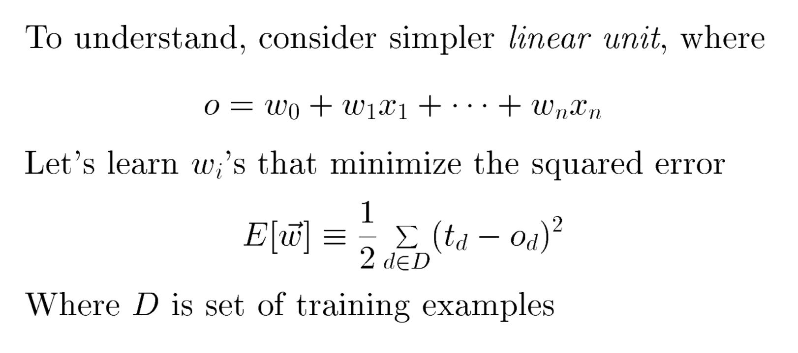
Gradient Descent*
*Courtesy of our course book

Slide 102
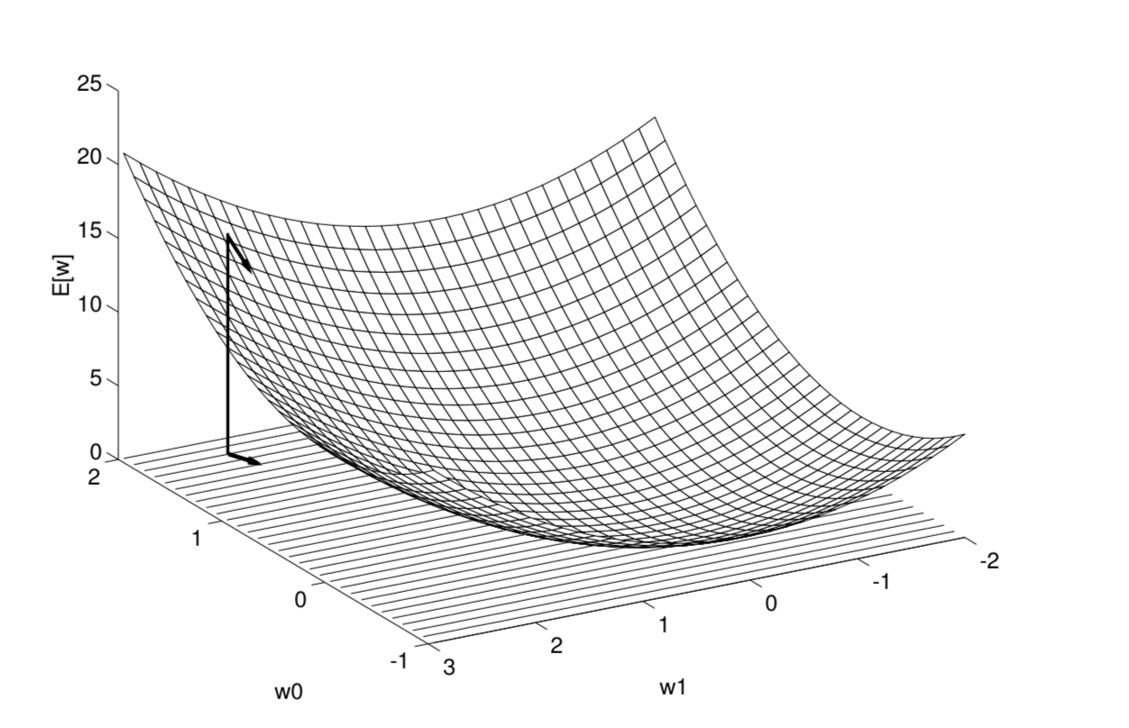
Gradient Descent

Slide 103
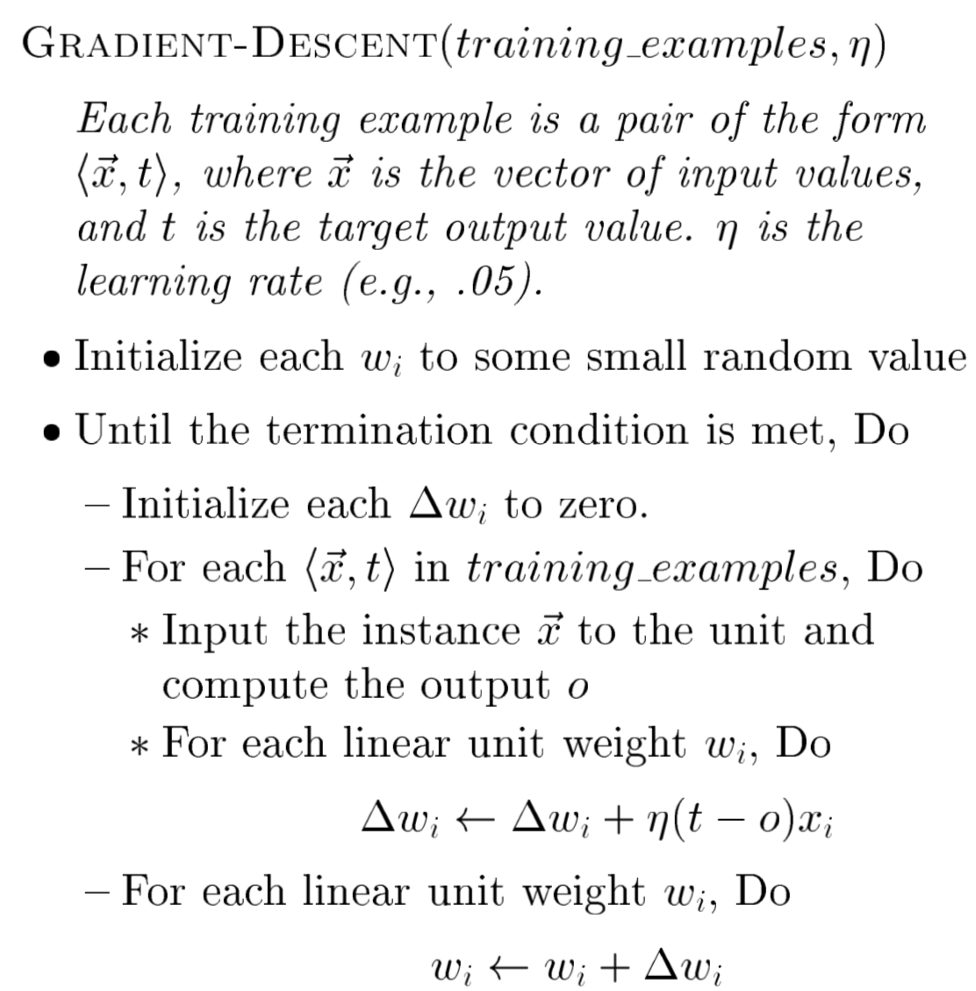
Algorithm

Slide 104
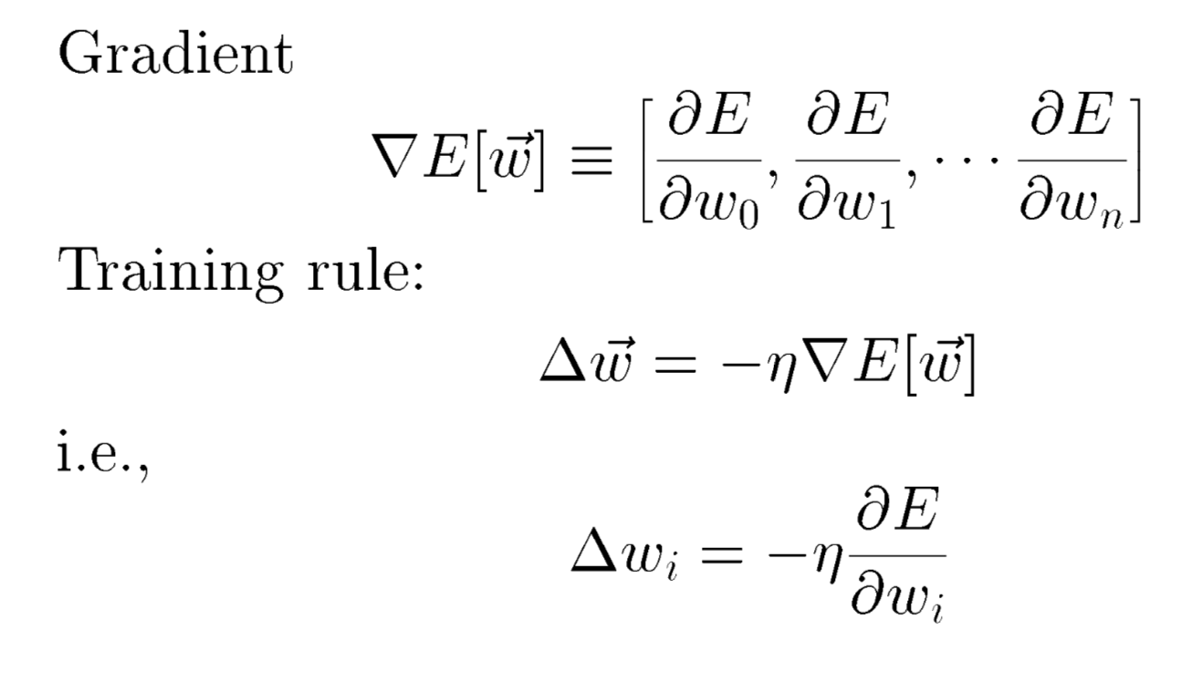
Gradient Descent

Slide 105
Ok, Then What the hell is an Artificial Neural Network (ANN)?
An ANN is mathematical model designed to solve engineering problems
Group of highly connected artificial neurons to realize compositions of non-linear functions (usually one of the ones we just looked at)
Trainable with 1-dimension gradient descent
Tasks that can be reduced to 1-layer ANN:
Classification
Discrimination
Estimation

Slide 106
Ok, Then What the hell is an Artificial Neural Network (ANN)?
An ANN is mathematical model designed to solve engineering problems
Group of highly connected artificial neurons to realize compositions of non-linear functions (usually one of the ones we just looked at)
Tasks that can be reduced to 1-layer ANN:
Classification
Discrimination
Estimation
…
… needs to be linearly separable!

Slide 107
What are their functioning principles?
Gradually descend towards a values matrix that matches the function that I’m trying to emulate;
Essentially model a random plane to look like separating hyperplane that I’m looking for;
Gradient descent is the «modeller» algorithm;

Slide 108
When do I use them?
When the problem decision surface is linearly separable!

Slide 109
Conclusions
ANNs, yet another ML technique feat. Perceptrons!
More appropriate emulation of human brain;
Input needs to be linearly separable or else I will need more layers;
More Layers or different algorithms ➔ different ANN!
Possibly noisy data... Poses a problem for Overfitting!*
*further down the line in this course

Slide 110
Feed Forward Neural Networks
The information is propagated from the inputs to the outputs
Directed Acyclic Graph (DAG)
Computes one or more non-linear functions
Computation is carried out by composition of some number of algebraic functions implemented by the connections, weights and biases of the hidden and output layers
Hidden layers compute intermediate representations
Dimension reduction
Time has no role -- no cycles between outputs and inputs
Output layer
2nd hidden
layer
1st hidden
layer
x₁
x₂
…..
x_{n}
We say that the input data, or features, are n dimensional

Slide 111
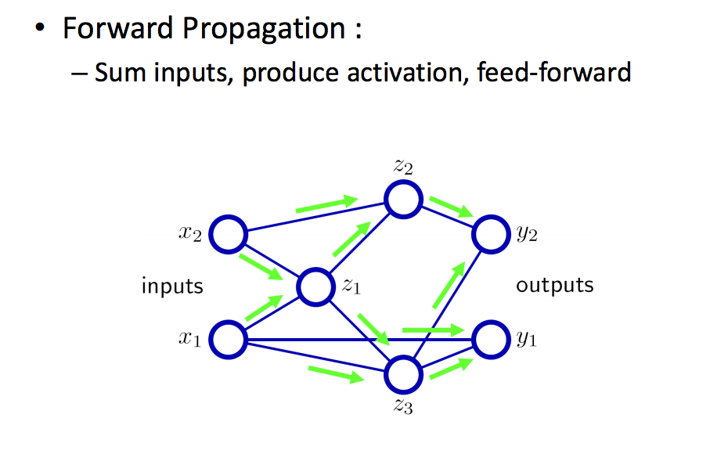
Forward Propagation in a Cartoon

Slide 112
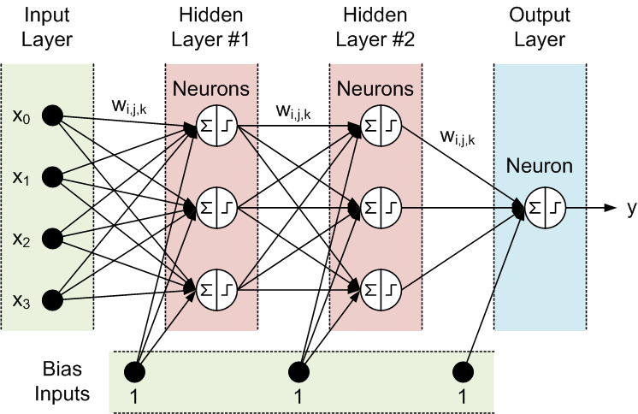
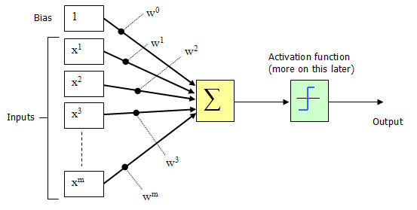
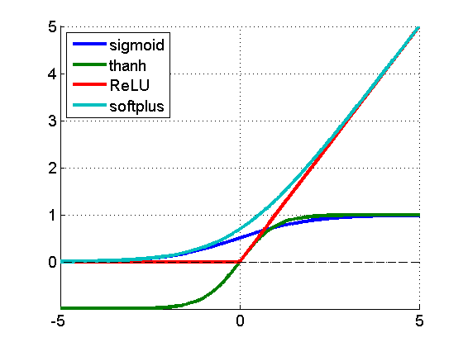
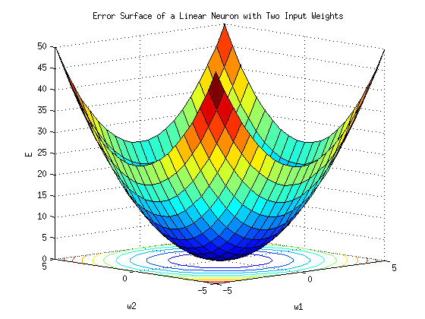
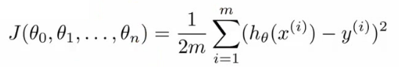
Recursive (Deep) Feed Forward Neural Nets in 1 Slide (☺)
(x^{(i)},y^{(i)})
h_{θ}(x^{(i)})
Where do the weights come from?
hypothesis
Forward Propagation
So what then is learning?
Learning is the adjusting of the weights w_{i,j} such that
the cost function J(θ) is minimized (a form of Hebbian learning).
Simple learning procedure: Back Propagation (of the error signal)

Slide 113
Questions?
Thanks!

Slide 114
Required Reading
T. Mitchell Book Ch. 4;
Lecture notes + Related material (see slides comments);

